Slide 1
9
Foundations
of Individual Behavior
Copyright ©2017 Pearson Education, Inc.
9-<number>

Slide 2
Learning Outcomes
Identify the focus and goals of organizational behavior (OB).
Explain the role that attitudes play in job performance.
Describe different personality theories.
Copyright ©2017 Pearson Education, Inc.
9-<number>
Notes:
After studying this chapter, you will be able to:
Identify the focus and goals of organizational behavior (OB).
Explain the role that attitudes play in job performance.
Describe different personality theories.

Slide 3
Learning Outcomes
(cont.)
Describe perception and the factors that influence it.
Discuss learning theories and their relevance in shaping behavior.
Discuss contemporary issues in OB.
Copyright ©2017 Pearson Education, Inc.
9-<number>
Notes:
After studying this chapter, you will be able to:
Describe perception and the factors that influence it.
Discuss learning theories and their relevance in shaping behavior.
Discuss contemporary issues in OB.

Slide 4
9-1
Identify the focus and goals of organizational behavior (OB).
Copyright ©2017 Pearson Education, Inc.
9-<number>

Slide 5
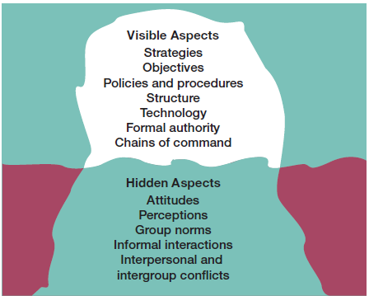
Organizational Behavior
Copyright ©2017 Pearson Education, Inc.
9-<number>
Notes:
Organizational behavior (OB) is the study of the actions of people at work.
One challenge in understanding organizational behavior is that it addresses issues that aren’t obvious. Like an iceberg, OB has a small visible dimension and a much larger hidden portion—as seen in Exhibit 9-1.
When we look at an organization, we see its visible aspects—such as strategies, objectives, policies and procedures, structure, technology, formal authority relationships, and chain of command. But under the surface are other elements that also influence how employees behave at work.
Organizational behavior focuses on three major areas:
Individual behavior, which includes attitudes, personality, perception, learning, and motivation.
Group behavior, which includes norms, roles, team building, leadership, and conflict.
Organizational aspects, which include structure, culture, and human resource policies and practices.

Slide 6
Goals of
Organizational Behavior
Employee productivity
Absenteeism
Turnover
Organizational citizenship behavior
Job satisfaction
Workplace misbehavior
Copyright ©2017 Pearson Education, Inc.
9-<number>
Notes:
The goals of OB are to explain, predict, and influence behavior. Managers need to be able to:
Explain why employees engage in some behaviors rather than others.
Predict how employees will respond to various actions and decisions.
Influence how employees behave.
The employee behaviors that we are specifically concerned with explaining, predicting, and influencing are:
1. Employee productivity, a performance measure of both work efficiency and effectiveness. Managers want to know what factors will influence the efficiency and effectiveness of employees.
2. Absenteeism is the failure to show up for work, which costs organizations an average of 35 percent of payroll.
3. Turnover is the voluntary and involuntary permanent withdrawal of employees from an organization. This can be a particularly costly problem due to increased recruiting, selection, and training costs and work disruptions.
4. Organizational citizenship behavior (OCB) is discretionary behavior that’s not part of an employee’s formal job requirements, but which promotes effective functioning of the organization. Examples of good OCB include helping others on one’s work team, volunteering for extended job activities, avoiding unnecessary conflicts, and making constructive statements about one’s work group and the organization. Organizations need individuals who will do more than their usual job duties and research shows that organizations that have such employees outperform those that don’t.
5. Job satisfaction refers to an employee’s general attitude toward his or her job. Satisfied employees are more likely to show up for work, have higher levels of performance, and stay with an organization.
6. Workplace misbehavior is any intentional employee behavior that is potentially harmful to the organization or to individuals within the organization. Workplace misbehavior shows up in organizations in four ways: deviance, aggression, antisocial behavior, and violence.

Slide 7
9-2
Explain the role that attitudes play in job performance.
Copyright ©2017 Pearson Education, Inc.
9-<number>

Slide 8
Attitudes and Job Performance
Job satisfaction
Job involvement
Organizational commitment
Employee engagement
Copyright ©2017 Pearson Education, Inc.
9-<number>
Notes:
Attitudes are evaluative statements, either favorable or unfavorable, concerning objects, people, or events. They reflect how an individual feels about something, such as, “I like my job.”
Looking at attitudes as being made up of three components—cognition, affect, and behavior—helps to illustrate their complexity. But keep in mind that the term “attitude” usually refers only to the affective component.
Managers are specifically interested in job-related attitudes, and the most important and most studied are job satisfaction, job involvement, and organizational commitment.
Job satisfaction is an employee’s general attitude toward his or her job. When people speak of employee attitudes, more often than not they mean job satisfaction.
Job involvement is the degree to which an employee identifies with his or her job, actively participates in it, and considers his or her job performance important for self-worth.
Organizational commitment is an employee’s orientation toward the organization in terms of his or her loyalty to, identification with, and involvement in the organization.
Employee engagement, a new concept generating widespread interest, happens when employees are connected to, satisfied with, and enthusiastic about their jobs. Highly engaged employees are passionate about and deeply connected to their work; disengaged employees have essentially “checked out” and don’t care.
A global study of more than 12,000 employees found that the top five engagement factors are:
- Respect
- Type of work
- Work/life balance
- Providing good service to customers
- Base pay
Highly engaged employees increase benefits and reduce costs. They’re two and a half times more likely to be top performers and remain with the organization, which reduces recruiting and training costs. This winning combination of higher performance and lower costs contributes to superior financial performance.

Slide 9
Attitudes and Consistency
Cognitive dissonance:
any incompatibility or inconsistency between attitudes or between behavior and attitudes.
Copyright ©2017 Pearson Education, Inc.
9-<number>
Notes:
Research shows that individuals generally try to reconcile differing attitudes and to align their attitudes and behavior so that they appear rational and consistent. They do this by altering either the attitudes or the behavior, or by developing a rationalization for the discrepancy.
Does this mean that we can predict an individual’s behavior if we know his or her attitude on a subject? Not necessarily, according to the theory of cognitive dissonance, proposed by Leon Festinger in the 1950s.
Cognitive dissonance is any incompatibility or inconsistency between attitudes or between behavior and attitudes. The theory argues that inconsistency is uncomfortable and that individuals try to reduce the discomfort and thus, the dissonance.
The theory proposed that how hard we try to reduce dissonance is determined by three things:
The importance of the factors creating the dissonance.
The degree of influence the individual believes he or she has over those factors.
The rewards that may be involved in dissonance.
These moderating factors suggest that if the issues underlying the dissonance are of minimal importance, if an individual perceives that the dissonance is externally imposed and is substantially uncontrollable, or if rewards are significant enough to offset the dissonance, the individual will not be under great tension to reduce the dissonance.

Slide 10
Understanding Attitudes
Satisfied employees have lower rates of turnover and absenteeism
Satisfied employees perform better on the job
Survey employees about their attitudes
Employees will try to reduce dissonance.
Copyright ©2017 Pearson Education, Inc.
9-<number>
Notes:
Employees’ attitudes influence behavior. For example, satisfied and committed employees have lower rates of turnover and absenteeism. If managers want to keep resignations and absences down—especially among their more productive employees—they’ll want to do things that generate positive job attitudes.
To do this, managers should focus on factors that are conducive to high levels of employee job satisfaction, which are likely to help employees be more productive, such as:
Making work challenging and interesting.
Providing equitable rewards.
Creating supportive working conditions and supportive colleagues.
Managers should also survey employees about their attitudes multiple times to more effectively pinpoint employee dissatisfaction. Also, managers should know that employees will try to reduce dissonance, so managers might point to external forces such as competitors, customers, or other factors—or provide rewards that the employee desires—when explaining the need to perform work about which that employee may feel some dissonance.

Slide 11
9-3
Describe different personality theories.
Copyright ©2017 Pearson Education, Inc.
9-<number>

Slide 12
Personality Theories
Personality:
a unique combination of emotional, thought, and behavioral patterns that affect how a person reacts to situations and interacts with others.
Copyright ©2017 Pearson Education, Inc.
9-<number>
Notes:
An individual’s personality is a unique combination of emotional, thought, and behavioral patterns that affect how a person reacts to situations and interacts with others. Often described in terms of measurable traits that a person exhibits, personality—just like attitudes—affects how and why people behave the way they do.
Through the years, researchers have attempted to focus on which personality types and personality traits would best identify information about an individual. Two of the most widely recognized efforts are the Myers-Briggs Type Indicator® and the Big Five model of personality.
The Myers-Briggs Type Indicator (MBTI®) assessment uses four dimensions of personality to identify 16 different personality types based on the responses to an approximately 100-item questionnaire.
The 16 personality types are based on four dimensions: Extraversion versus Introversion (EI), Sensing versus Intuition (SN), Thinking versus Feeling (TF), and Judging versus Perceiving (JP).
The EI dimension describes an individual’s orientation toward the external world of the environment (E) or the inner world of ideas and experiences (I).
The Sensing-Intuition dimension indicates an individual’s preference for gathering data while focusing on a standard routine based on factual data (S) versus focusing on the big picture and making connections among the facts (N).
Thinking-Feeling reflects an individual’s preference for making decisions in a logical and analytical manner (T) or on the basis of values and beliefs and the effects the decision will have on others (F).
The Judging-Perceiving index reflects an individual’s attitude toward dealing with the external world, either in a planned and orderly way (J) or a flexible and spontaneous way (P).
So, an ISTJ (Introversion - Sensing – Thinking - Judging) person is quiet, serious, dependable, practical, and matter-of-fact, whereas an ESFP (Extraversion - Sensing - Feeling - Perceiving) is outgoing, friendly, spontaneous, enjoys working with others, and learns best by trying a new skill with other people.

Slide 13
Big Five Model of Personality
The Big Five factors are:
Extraversion
Agreeableness
Conscientious
Emotional stability
Openness to experience
Copyright ©2017 Pearson Education, Inc.
9-<number>
Notes:
Another way of viewing personality is through a five-factor model of personality—more typically called the Big Five model.
Extraversion describes the degree to which someone is sociable, talkative, and assertive.
Agreeableness describes the degree to which someone is good-natured, cooperative, and trusting.
Conscientiousness describes the degree to which someone is responsible, dependable, persistent, and achievement oriented.
Emotional stability describes the degree to which someone is calm, enthusiastic, and secure (positive) or tense, nervous, depressed, and insecure (negative).
Openness to experience describes the degree to which someone is imaginative, artistically sensitive, and intellectual.
The Big Five model provides more than just a personality framework. Research has shown that important relationships exist between these personality dimensions and job performance. For example, one study reviewed five categories of occupations—professionals (for example, engineers, architects, and attorneys), police, managers, employees in sales, and semiskilled and skilled employees—with respect to job performance. The results showed that conscientiousness predicted job performance for all five occupational groups.
Predictions for the other personality dimensions depended on the situation and the occupational group. For example, extraversion predicted performance in managerial and sales positions, and openness to experience predicted training competency.

Slide 14
Emotional Intelligence
Five dimensions:
  Self-awareness
  Self-management
  Self-motivation
  Empathy
  Social skills
Copyright ©2017 Pearson Education, Inc.
9-<number>
Notes:
People who understand their own emotions and are good at reading others’ emotions may be more effective in their jobs. Therefore, emotional intelligence (EI) can be described as an assortment of non-cognitive skills, capabilities, and competencies that influences a person’s ability to cope with environmental demands and pressures.
Emotional intelligence is composed of five dimensions:
Self-awareness, or being aware of what you’re feeling.
Self-management of your own emotions and impulses.
Self-motivation, or persistence in the face of setbacks and failures.
Empathy, or the ability to sense how others are feeling.
Social skills, which means adapting to and handling the emotions of others.
Several studies suggest that EI plays an important role in job performance and the implication is that employers should consider emotional intelligence as a criterion in their selection process—especially for those jobs that demand a high degree of social interaction.

Slide 15
Personality Traits
Can personality traits predict practical work-related behaviors?
Yes!
Copyright ©2017 Pearson Education, Inc.
9-<number>
Notes:
In a word, “YES!” The following five specific personality traits have proven most powerful in explaining individual behavior in organizations:
Locus of control
Machiavellianism
Self-esteem
Self-monitoring
Risk propensity
The locus of control is the degree to which people believe they control their own fate and, in some work situations, whether they tend to blame others or examine their own actions when there’s a negative situation.
Machiavellianism is named after Niccolo Machiavelli, known for his instruction on gaining and manipulating power in the 16th century. A high “Mach” is pragmatic, maintains emotional distance, believes that ends can justify the means, and may have beliefs that are less ethical.
The degree to which individuals like or dislike themselves is a trait called self-esteem (SE). High SEs believe that they can succeed, take more risks in job selection, and are more likely to choose unconventional jobs. Low SEs are dependent on positive evaluations from others, more prone to conform to the beliefs and behaviors of those they respect, and less satisfied with their jobs.
Self-monitoring is a trait that measures an individual’s ability to adjust behavior to external, situational factors. High self-monitors can present striking contradictions between their public persona and their private selves and are more capable of conforming than low self-monitors are. We might hypothesize that high self-monitors will be more successful in managerial positions that require individuals to play multiple, and even contradicting, roles.
The final personality trait influencing worker behavior is risk taking. A preference for assuming or avoiding risk impacts how long it takes an individual to make a decision and how much information they require before choosing. In one classic study, high risk-taking managers made more rapid decisions and used less information than low risk-taking managers, but the decision accuracy was the same for both groups.
Although it’s generally correct to conclude that managers in organizations are risk averse, especially in large companies and government bureaus, individual differences exist. Therefore, it makes sense to consider aligning risk-taking propensity with specific job demands.

Slide 16
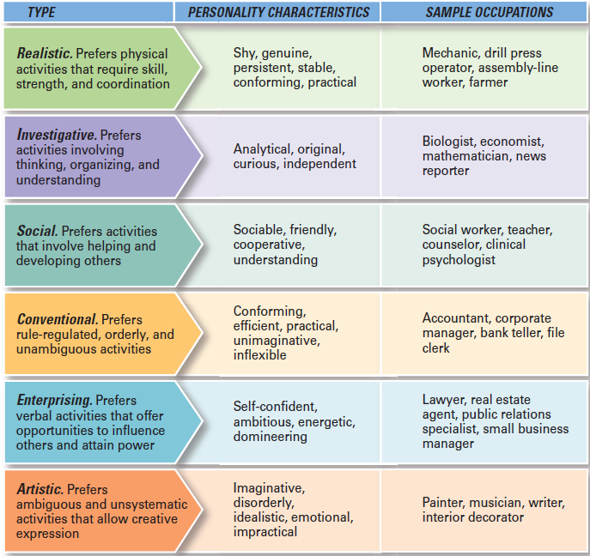
Matching Personalities and Jobs
Copyright ©2017 Pearson Education, Inc.
9-<number>
Notes:
Obviously, individual personalities differ. So do jobs. How do we match the two? The best-documented personality-job fit theory was developed by psychologist John Holland, and states that an employee’s satisfaction with his or her job, as well as his or her likelihood of leaving that job, depends on the degree to which the individual’s personality matches the job environment.
Holland identified six basic personality types, as seen here in Exhibit 9-2:
Realistic
Investigative
Social
Conventional
Enterprising
Artistic

Slide 17

Personality Traits
Across Cultures
National cultures differ in terms of the degree to which people believe they control their environment.
Copyright ©2017 Pearson Education, Inc.
9-<number>
Notes:
Do personality frameworks like the Big Five model translate across cultures?
Actually, the five personality factors studied in the Big Five model appear in almost all cross-cultural studies, with differences found only in the emphasis on dimensions. The Chinese, for example, use the category of conscientiousness more often and use the category of agreeableness less often than Americans do. But a surprisingly high amount of correspondence is found, especially among individuals from developed countries.
There are certainly no common personality types for a given country, yet a country’s culture influences the dominant personality characteristics of its people as reflected by locus of control. National cultures differ in terms of the degree to which people believe they control their environment. For instance, North Americans believe that they can dominate their environment, while other societies in Middle Eastern countries believe that life is essentially predetermined. On the basis of this particular cultural characteristic, we should expect a larger proportion of “internals” in the U.S. and Canadian workforces than in the workforces of Saudi Arabia or Iran.
For global managers, understanding how personality traits differ takes on added significance when looking at them from the perspective of national culture. For example, knowing that the trait of conscientiousness is a valid predictor of performance in European Community nations helps U.S.-based Burger King manage employees such as this BK employee in France.

Slide 18
Understanding Personality
  Job-person compatibility
  Understanding different approaches to work
  Being a better manager
Copyright ©2017 Pearson Education, Inc.
9-<number>
Notes:
About 62 percent of companies use personality tests when recruiting and hiring because managers are likely to have higher-performing and more-satisfied employees if consideration is given to matching personalities with jobs.
In addition, compatibility leads to other benefits. By recognizing that people approach problem solving, decision making, and job interactions differently, a manager can better understand why, for instance, an employee is uncomfortable with making quick decisions or why an employee insists on gathering as much information as possible before addressing a problem. In the same vein, managers can expect that individuals with an external locus of control may be less satisfied with their jobs than those with an internal locus, and also that they may be less willing to accept responsibility for their actions.
One of the skills you have to develop as a manager is learning to fine-tune your emotional reactions according to the situation. In other words, you have to learn to recognize when “you have to smile and when you have to bark.”

Slide 19
9-4
Describe perception and the factors that influence it.
Copyright ©2017 Pearson Education, Inc.
9-<number>

Slide 20

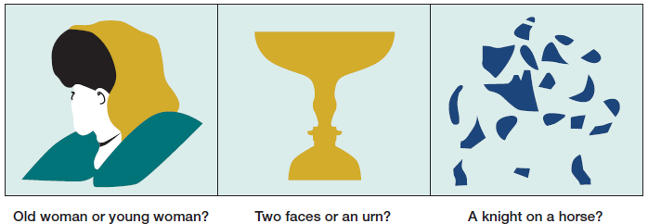
Perception
Copyright ©2017 Pearson Education, Inc.
9-<number>
Notes:
Perception is a process by which we give meaning to our environment by organizing and interpreting sensory impressions.
Research consistently demonstrates that individuals may look at the same thing yet perceive it differently. For example, one manager can interpret the fact that her assistant takes several days to make important decisions as evidence that the assistant is slow, disorganized, and afraid to make decisions. Another manager with the same assistant might perceive the assistant as thoughtful, thorough, and deliberate. The point is, none of us sees an objective reality; we just interpret what we see and call it reality.
Perception can be shaped or distorted by a number of factors that reside in the perceiver, in the object or target being perceived, or in the context of the situation in which the perception is made.
Because we do not look at targets in isolation, the relationship of a target to its background also influences perception—as seen here in Exhibit 9-3—as does our tendency to group close things and similar things together. The context, time, and other situational factors in which we see objects or events is also important.

Slide 21
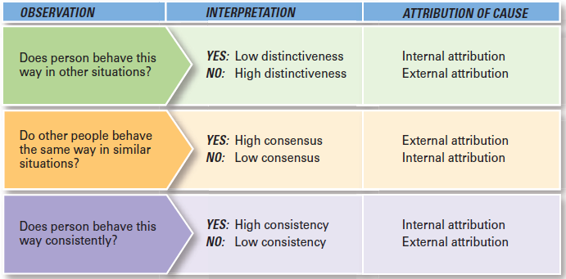
Judging Employees
Copyright ©2017 Pearson Education, Inc.
9-<number>
Notes:
Our perception and judgment of a person’s actions will be significantly influenced by the assumptions we make about the person’s internal state, which has led researchers to develop attribution theory.
Attribution theory attempts to explain how we judge people differently depending on what meaning we attribute to a given behavior. This depends on three factors: distinctiveness, consensus, and consistency.
Distinctiveness refers to whether an individual displays a behavior in many situations or whether it is particular to one situation. If an employee who arrived late to work today is also the person coworkers see as a goof-off, then we want to know whether this behavior is unusual. If it is, the observer is likely to give the behavior an external attribution. If this action is not unique, it will probably be judged as internal.
A behavior shows consensus if everyone faced with a similar situation responds in the same way. If consensus is high, you would be expected to give an external attribution to the behavior. But if only one person responds that way, you would conclude the reason to be internal.
Finally, a manager looks for consistency in an employee’s actions. The more consistent the behavior, the more the observer is inclined to attribute it to internal causes.
Exhibit 9-4 summarizes the key elements in attribution theory. It would tell us, for instance, that if an employee, Mr. Flynn, generally performs at about the same level on other related tasks as he does on his current task (low distinctiveness), if other employees frequently perform differently—better or worse—than Mr. Flynn does on that current task (low consensus), and if Mr. Flynn’s performance on this current task is consistent over time (high consistency), any manager judging Mr. Flynn’s work is likely to hold him primarily responsible for his task performance (internal attribution).

Slide 22
Distorted Attributions
Fundamental attribution error:
the tendency to underestimate the influence of external factors and overestimate the influence of internal factors when making judgments about the behavior of others.
Self-serving bias:
the tendency for individuals to attribute their successes to internal factors while putting the blame for failures on external factors.
Copyright ©2017 Pearson Education, Inc.
9-<number>
Notes:
One of the more interesting findings drawn from attribution theory is that errors or biases distort attributions. For instance, substantial evidence supports the hypothesis that when we make judgments about the behavior of other people, we tend to underestimate the influence of external factors and overestimate the influence of internal or personal factors. This fundamental attribution error can explain why a sales manager may be prone to attribute the poor performance of her sales agents to laziness rather than to a competitor’s innovative product line.
Individuals generally attribute their own successes to internal factors, such as ability or effort, while blaming failure on external factors. This self-serving bias suggests that employees will distort feedback from performance reviews, whether the feedback is positive or negative.

Slide 23
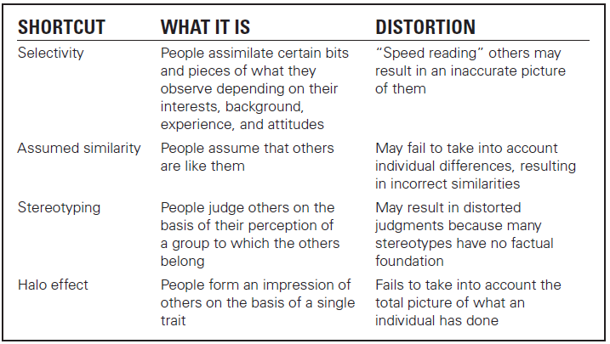
Perceptual Shortcuts
Copyright ©2017 Pearson Education, Inc.
9-<number>
Notes:
All of us, managers included, use shortcuts to make the task of perceiving and interpreting others’ behaviors more manageable.
Here in Exhibit 9-5 we see a summary of these perceptual shortcuts. Because individuals can’t assimilate all they observe, they’re selective in their perception, depending on their interests, background, experience, and attitudes. Selective perception allows us to “speed read” others but not without the risk of drawing an inaccurate picture.
It’s easy to judge others if we assume that they’re similar to us. In assumed similarity, the observer’s perception of others is influenced more by his or her own characteristics than by those of the person observed. For example, if you want challenges and responsibility in your job, you’ll assume that others want the same thing.
When we judge someone on the basis of our perception of a group he or she is part of, we’re using the shortcut called stereotyping. For instance, the statement “Married people are more stable employees than single people” is an example of stereotyping. To the degree that the stereotype is based on fact, it may produce accurate judgments—but many stereotypes aren’t factual and distort our judgment.
Another shortcut is the halo effect, where we form a general impression about a person on the basis of a single characteristic, such as intelligence, sociability, or appearance.

Slide 24
Understanding Perception
Employees react to perception, not reality
The potential for perceptual distortion exists
Copyright ©2017 Pearson Education, Inc.
9-<number>
Notes:
Managers need to recognize that their employees react to perceptions, not to reality. So whether the organization’s wage levels are among the highest in the community is less relevant than what employees perceive them to be. If individuals perceive wage levels as low, they’ll behave as if those conditions actually exist.
Employees organize and interpret what they see, so there is always the potential for perceptual distortion. The message is clear: Pay close attention to how employees perceive both their jobs and management actions.

Slide 25
9-5
Discuss learning theories and their relevance in shaping behavior.
Copyright ©2017 Pearson Education, Inc.
9-<number>

Slide 26


Operant Conditioning
Copyright ©2017 Pearson Education, Inc.
9-<number>
Notes:
Almost all behavior is learned, so if we want to explain, predict, and influence behavior, we need to understand how people learn. Learning occurs all the time and can be defined as any relatively permanent change in behavior that occurs as a result of experience.
Two learning theories that help us understand how and why individual behavior occurs are operant conditioning and social learning. First we will discuss operant conditioning.
Operant conditioning argues that behavior is a function of its consequences. Operant behavior is voluntary: People learn to behave to get something they want or to avoid something they don’t want. Reinforcement strengthens a behavior and increases the likelihood that it will be repeated. Lack of reinforcement has the opposite effect.

Slide 27
Social Learning Theory
Learning both through:
observation and direct experience
Copyright ©2017 Pearson Education, Inc.
9-<number>
Notes:
Social learning theory holds that people learn through both observation and direct experience. The influence of others (parents, teachers, peers, celebrities, managers, etc.) is central to the social learning viewpoint and the amount of influence that these models have on an individual is determined by four processes:
Attentional processes. People learn from a model when they recognize and pay attention to its critical features.
Retention processes. A model’s influence will depend on how well the individual remembers the model’s action, even after the model is no longer readily available.
Motor reproduction processes. After a person has seen a new behavior by observing the model, the watching must become doing.
Reinforcement processes. Individuals will be motivated to exhibit the modeled behavior if positive incentives or rewards are provided. Behaviors that are reinforced will be given more attention, learned better, and performed more often.

Slide 28
Shaping Behavior
Positive reinforcement
Negative reinforcement
Punishment
Extinction
Copyright ©2017 Pearson Education, Inc.
9-<number>
Notes:
Managers can teach employees to behave in ways that most benefit the organization. They do this by guiding learning in graduated steps that is, shaping behavior.
There are four ways to shape behavior.
Positive reinforcement is when a desired behavior is followed with something pleasant, such as praise for a job well done.
Negative reinforcement is when a desired behavior is followed by the termination or withdrawal of something unpleasant. For example, a manager telling an employee he won’t dock her pay if she starts coming to work on time. The only way for the employee not to have her pay docked is to come to work on time, which is the behavior the manager wants.
Punishment penalizes undesirable behavior. Suspending an employee for two days without pay for showing up drunk is an example of punishment.
Extinction is the not reinforcing (ignoring) a behavior, making it gradually disappear.
Both positive and negative reinforcement result in learning because they strengthen a desired response and increase the probability of repetition. Both punishment and extinction also result in learning; however, they weaken behavior and tend to decrease its subsequent frequency.

Slide 29

Managing Employees’ Learning
  Watch what you reward
  Watch what you do
Copyright ©2017 Pearson Education, Inc.
9-<number>
Notes:
Employees are going to learn on the job.
If managers want behavior A, but reward behavior B, they shouldn’t be surprised to find employees learning to engage in behavior B.
Similarly, managers should expect that employees will look to them as models.

Slide 30
9-6
Discuss contemporary issues in OB.
Copyright ©2017 Pearson Education, Inc.
9-<number>

Slide 31
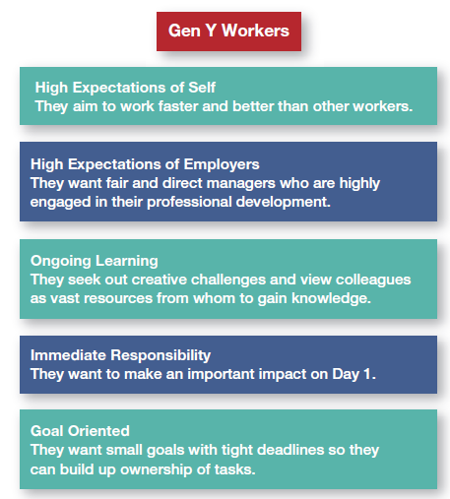
Contemporary Issues
Copyright ©2017 Pearson Education, Inc.
9-<number>
Notes:
Two contemporary OB issues managers face today are generational differences and negative behaviors in the workplace.
Gen Y refers to individuals born from about 1982 to 1997 who bring new attitudes with them to the workplace. What Gen Ys want their work life to provide is shown here in Exhibit 9-6:
They have high expectations of themselves.
They have high expectations of employers.
They expect ongoing learning.
They expect immediate responsibility.
They are goal oriented.
As Gen Ys say of themselves, “We are willing and not afraid to challenge the status quo. An environment where creativity and independent thinking are looked upon as a positive is appealing to people my age. We’re very independent and tech savvy.”

Slide 32

Managerial Challenges
Copyright ©2017 Pearson Education, Inc.
9-<number>
Notes:
Managing Gen Y workers presents some unique challenges. Conflicts and resentment can arise over issues such as appearance, technology, and management style. One possible solution is being more flexible in what’s acceptable. For example, the guideline might be that when the person is not interacting with someone outside the organization, more casual wear (with some restrictions) can be worn.
This generation has lived much of their lives with cell phones, email, texting, laptops, and the Internet. When they don’t have information they need, they’re content to meet virtually, while baby boomers expect an in-person meeting. Baby boomers complain about Gen Y’s inability to focus on one task, while Gen Ys see nothing wrong with multitasking. Again, flexibility from both is the key.
When it comes to managing, Gen Y employees want bosses who are open minded; experts in their field; organized; teachers and mentors; respectful of their generation; understanding of their need for work-life balance; who provide constant feedback; who communicate in compelling ways; and who provide stimulating and novel learning experiences.
Gen Y employees have a lot to offer organizations in terms of their knowledge, passion, and abilities. Managers, however, have to recognize and understand the behaviors of this group in order to create an environment in which work can be accomplished efficiently, effectively, and without disruptive conflict.

Slide 33
Negative Behavior in the Workplace
Survey of U.S. Employees:
10% witnessed rudeness daily
20% were targets of incivility at least once/week
Copyright ©2017 Pearson Education, Inc.
9-<number>
Notes:
Rudeness, hostility, aggression, and other forms of workplace negativity have become all too common in today’s organizations. It’s been estimated that negativity costs the U.S. economy some $300 billion a year.
The best way to manage negative behavior in the workplace is to recognize that it’s there, confront such misbehaviors, and send a clear message as to what is expected and acceptable behavior.
Research seems to indicate that both preventive and responsive actions to negative behaviors are needed. Preventing negative behaviors by carefully screening potential employees for certain personality traits and responding immediately and decisively to unacceptable negative behaviors goes a long way toward managing negative workplace behaviors.
However, it’s also important to pay attention to employee attitudes because dissatisfied employees will express their dissatisfaction.

